Slide 1
Java Academy Cap Stone Project
EMR System
(Electronic Medical Records)
Patient Table
Presented & Contributed By :
Name : Raviteja Pathuri
Class : WFD Summer 2017 CYF701-4B1 - Java Programming 20171360027

Slide 2
GitHub URL:
https://github.com/raviptest5/RaviJA_DTCC

Slide 3
Introduction and background:
EMR is a web-based, data-driven patient management system used to add, update and delete patients records.
Once patient record is added/updated/deleted in the Web form, it will be reflected in database.

Slide 4
Objectives of EMR Application:
EMR reduces manual maintenance of patient records, by storing them in a central repository(database), providing no scope for errors & thereby reducing workload on hospital staff.
Features supported by this project:
Addition of new patient record.
Modifying an existing patient record (while modifying we can either save or delete or cancel that editing).
Display a list of all existing users.
Following filters can be applied for searching patient records- Filter by last name, Filter by First name

Slide 5
Software Requirements: Operating system: Windows 7 & above JAVA Version: JDK 1.8.x Web Server: Apache Tomcat 8.x Web Browsers: Chrome (v 64.0.3), Firefox (v57.0.4), IE (v11.0.51)
Hardware Requirements:
Processor Required: Intel Core i3 & above
RAM Required: Minimum 4 GB
Hard Disk Required: 500 GB or more

Slide 6
Technologies and tiers used:
Front End:
Vaadin Web UI Frame work (5.3)
Middleware:
JPA (v1.5.10)
Spring Boot (v1.5.10.RELEASE)
Maven (v4.0)
Database:
MySQL (v6.3.9)
Tiers :3-Tiered Architecture

Slide 7
Web Forms Screen shots (front end)

Slide 8
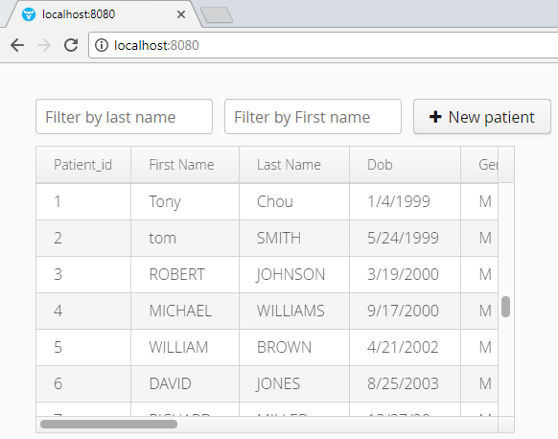
Home Page: Displays the list of users, and can be filtered on either Last name or First name

Slide 9
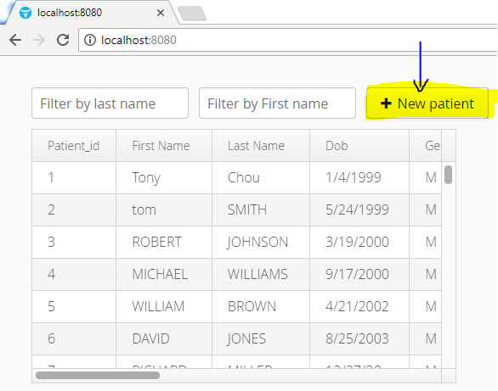
Add New Patient record: This feature is used to add a new patient record.

Slide 10
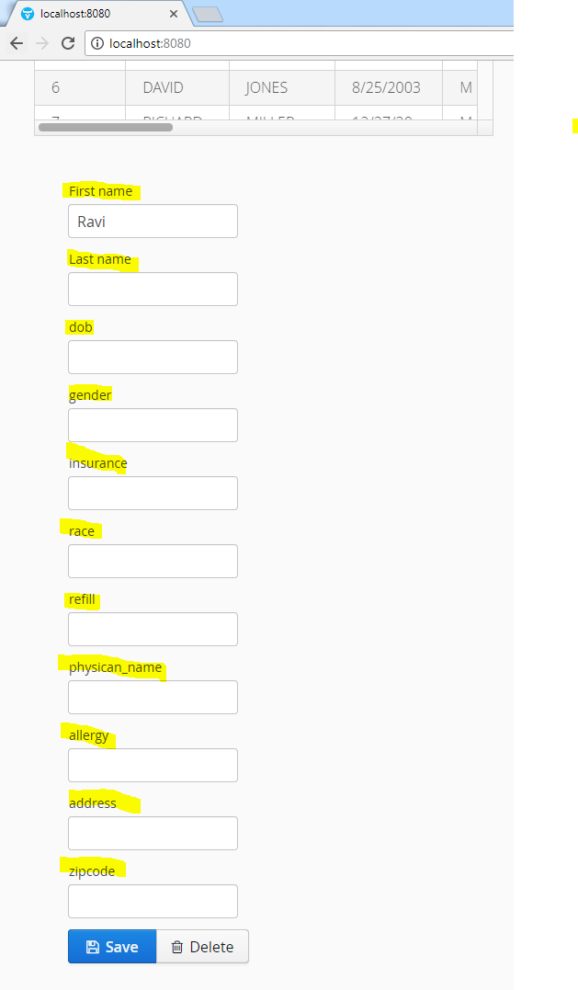
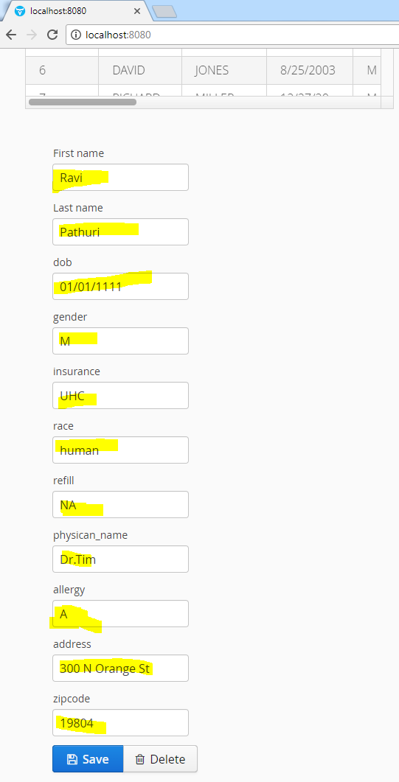
Patient Data Fields

Slide 11
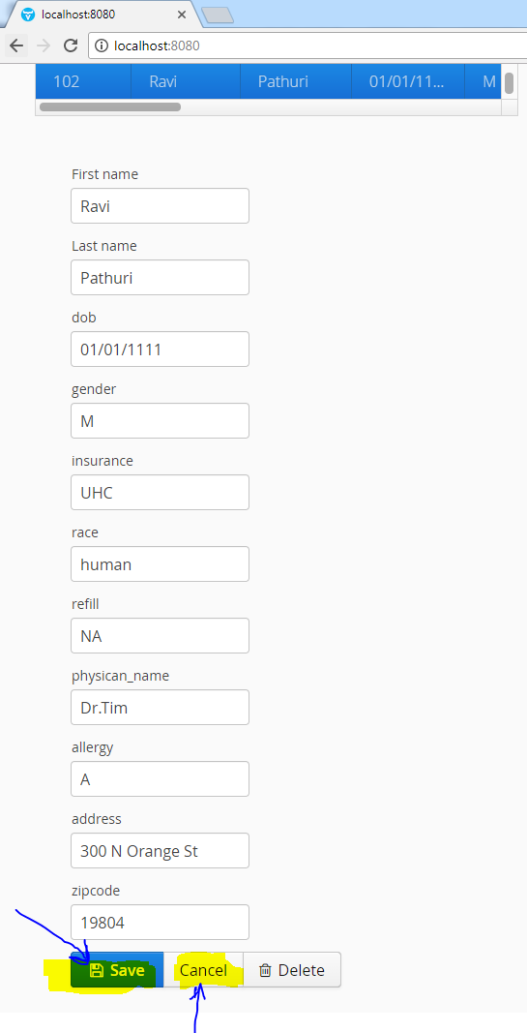
Update a Patient Record This feature allows user to edit the record and able to save it. Cancel is used to Cancel editing of record. We enter this screen after clicking on +New Patient or when the user is trying to edit the existing record.

Slide 12
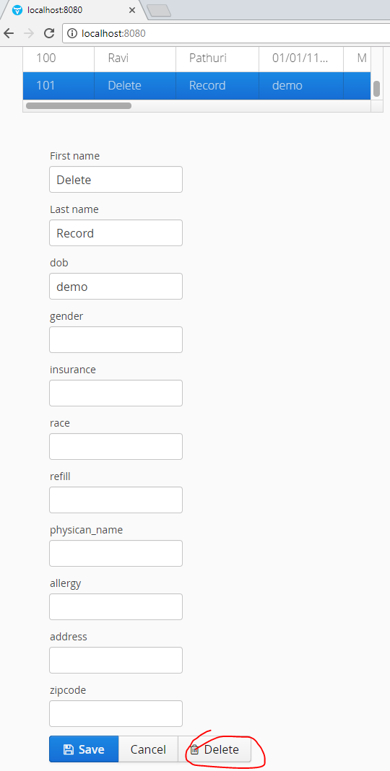
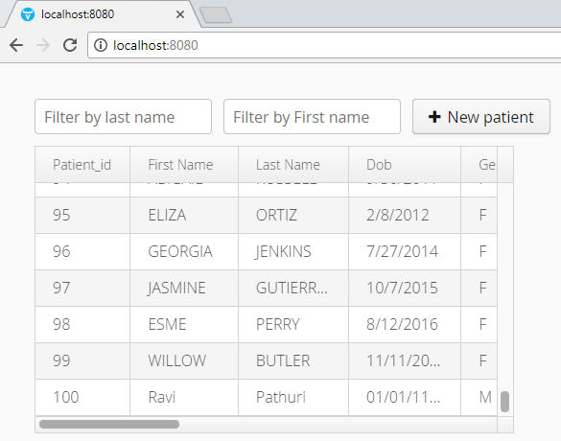
Delete a patient record: Delete option is used to delete a patient record permanently.

Slide 13
Challenges faced:
Setting up one-to-many relationships in the database.
Writing Junit test cases.

Slide 14
Conclusion:
The Electronic Medical Records (EMR) presented here is a web based application to Create/Update/Delete patient records in a central repository(database), with minimal manual intervention.

Slide 15
Queries?

Slide 16
Thank you

